Slide 2

Engineering OFSAAI 8.0.4 On Docker Containers
Andy Baker – Consulting Technical Director

Slide 3
Notes:
This is a Safe Harbor Front slide, one of two Safe Harbor Statement slides included in this template.
One of the Safe Harbor slides must be used if your presentation covers material affected by Oracle’s Revenue Recognition Policy
To learn more about this policy, e-mail: Revrec-americasiebc_us@oracle.com
For internal communication, Safe Harbor Statements are not required. However, there is an applicable disclaimer (Exhibit E) that should be used, found in the Oracle Revenue Recognition Policy for Future Product Communications. Copy and paste this link into a web browser, to find out more information.
http://my.oracle.com/site/fin/gfo/GlobalProcesses/cnt452504.pdf
For all external communications such as press release, roadmaps, PowerPoint presentations, Safe Harbor Statements are required. You can refer to the link mentioned above to find out additional information/disclaimers required depending on your audience.

Slide 4
Program Agenda
1
Docker History And Overview
Environment And The Oracle Container Cloud
OFSAA Docker Build Overview
Other Docker Images Available
Engineering Next Steps
Useful Docker Commands Appendix
2
3
4
5
6

Slide 5
The History Of Unix / Linux Containers
While Docker has been playing a key role in adoption of the Linux containers they did not invent the concept of container technology.
OCI 2015
rkt 2014
Docker 2013
LMCTFY 2013
Warden 2011
LCX 2008
AIX (6.1)WPARS 2007
cgroups in Linux Kernel (2.6.24) 2007
Process Containers 2006
openvz 2005
Oracle Solaris Zones 2004
Linux vserver 2001
FreeBSD Jails 2000
UNIX V7 added chroot 1979
Copyright © 2017, Oracle and/or its affiliates. All rights reserved. |

Slide 6
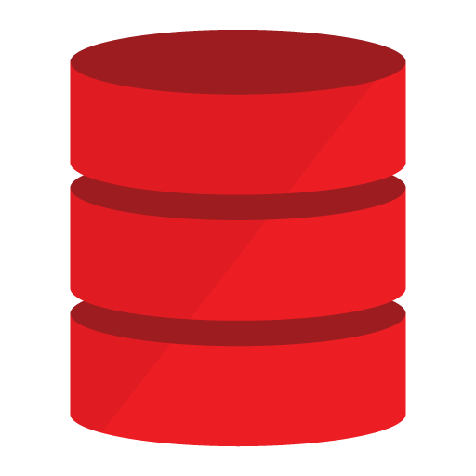
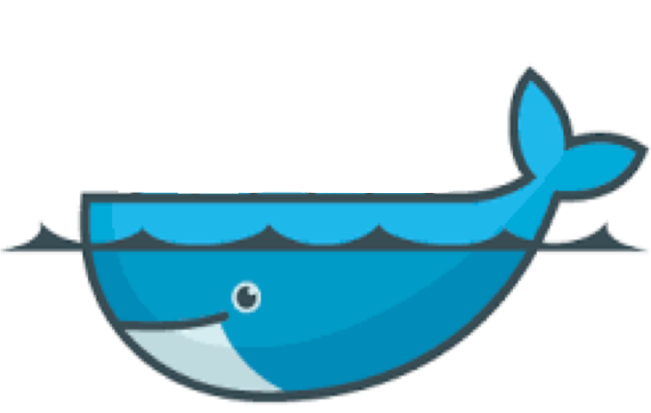
What is Docker?
Basic Terminology
Docker-Engine: The engine that runs containers / images
Images: A collection of software to be run as a container
Containers: A container on the Linux worker host running an image
Registry: A place to store and download images / push images into
Volumes: A place to persist data outside the container on the docker host
Service: A template for how to run a container
Stack: A template for how to run a multi-services (containers)
Deployment: One or more running containers created from services

Slide 7
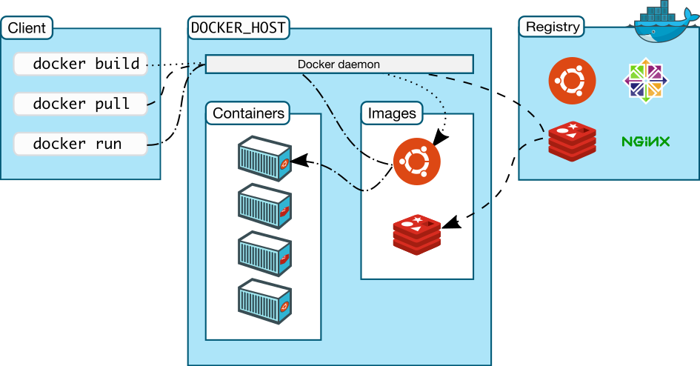

Docker Key Components
Registry
Images
Containers
Docker daemon/engine
Volumes

Slide 8
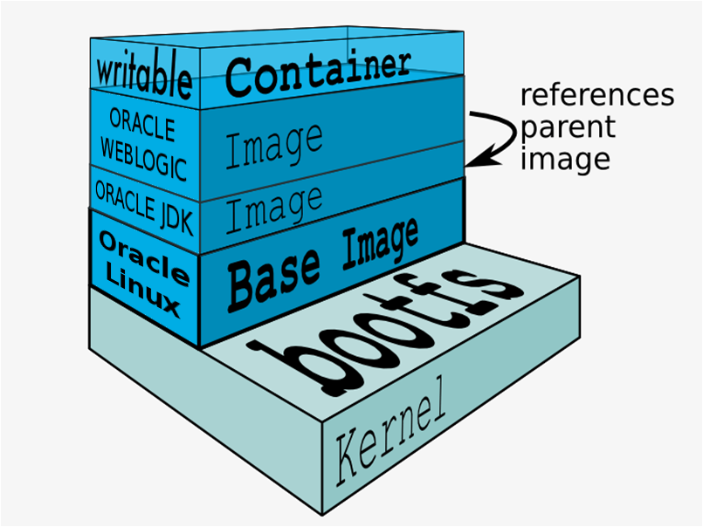

Docker Images
Containers have writeable file system
Recipes, the Dockerfiles, can be easily shared
Container as code
Images have layered file systems
Images can be extended
Images can be shared as binary files

Slide 9
The Architectural Differences: Container Vs VM
Image Creation
Key differences VMs Containers
Can be automated with 3rd-party tools (Chef/Puppet/etc), but takes a lot of time. Snapshots are bigger compared to Container images.
Same options as VMs + can also declaratively construct one using native, 1st class Dockerfile format.
Updates
Must use configuration management tool to apply updates. Or must update every single gold image and then re-deploy
Can apply diffs to container images, or more often, the image is quickly rebuilt and container re-deployed
Performance
Heavy weight – must often go through abstraction layers to access physical hardware resources
Lightweight – a container is just an operating system process. 100% native access to all physical hardware resources
Utilization
Harder to over-subscribe physical hardware resources like CPU and memory
Very easy to get to 100% consume physical hardware resources. Can easily move containers off of hosts when the hosts become too utilized

Slide 10
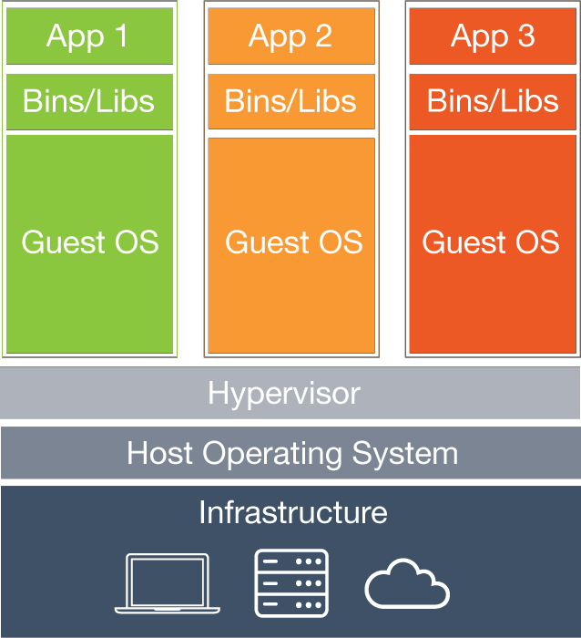
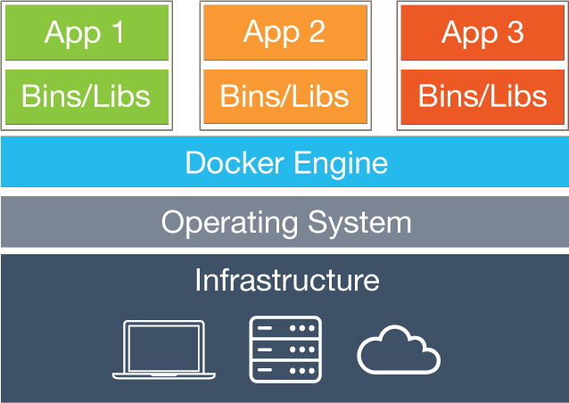
The Architectural Differences: Container Vs VM
Container
VM
Virtual Machines
● Each virtual machine (VM)
includes the app, the
necessary binaries and
libraries and an entire guest
operating system
Containers
● Containers include the app & all of its dependencies,
but share the kernel of hardware with other containers.
● Run as an isolated process in userspace on the host OS
● Not tied to any specific infrastructure – containers run
on any computer, infrastructure and cloud.

Slide 11
Frequently Asked Questions: Containers / VM’s
Q1. Containers, render hardware virtualization unnecessary: Why do you need virtual machines (VMs) now that you can run containers on physical hardware?
Answer: Running an application in production comes with an established set of operational requirements: security, compliance, performance, resource management, scalability, availability, data persistence, networking, and monitoring, High Availability, Disaster Recovery. Virtual platforms provide this, or you can invest heavily and build it yourself on bare metal?
The above is a main driver and ultimate reason consumers would choose this architecture.
Q2. Will organizations run containers on bare metal or VM’s?
Answer: Large enterprise environments will probably have a mix of virtualized servers, bare-metal physical hosts, and containers running in either depending on needs operational and performance. There is no cookie cut solution!

Slide 12
Frequently Asked Questions: Containers / VM’s
Q3. What are the Container benefits?
Answer: A container isolates your application from wherever you are running it. You install only what you need to run your application and nothing more. Containers allow developers to work with identical dev environments, stacks and quickly. You can also develop directly in a container as it gives you a separate network stack and storage without the overhead of building and running a virtual machine.
Q4. What drawbacks are there to using a VM?
Answer: Virtualization has an overhead; no matter how thin the operating system (OS) of the guest deployed, you still need to fully copy that OS and its entire configuration when establishing a new VM. Containers run their own init processes, filesystems and network stacks, which are virtualized on top of the VM or a bare metal host OS. By nature, containers use less memory than VMs. This is due to the fact that they inherently share the OS kernel and, in most cases, they also use the same identical libraries.

Slide 13
Frequently Asked Questions: Containers / VM’s
Q5. What is the overheads of running VM’s?
Answer: A typical hypervisor will have about a 12-15% overhead on a host CPU that leaves 85% CPU available after startup. Memory overheads will be in the region of 500Mb. Naturally, running a process on a guest operating system might also suffer from lack of resources and performs less efficiently than running the same process directly on a host (physical server) operating system.
For a good comparison of benefits / challenges with containers and virtualization please see this public webinar: https://www.stratoscale.com/resources/webinar/webinar-virtualization-vs-containers/?ban=blog_banner1
Q6. How much do containers Perform better on bare metal than virtualization?
Answer: The performance of containers running on bare metal is roughly 25%-30% better compared to running the same workloads on VMs in both CPU and IO operations.

Slide 14
Frequently Asked Questions: Docker?
Q7. How are containers persistent?
Answer: A container is able to have persistence by the use of volumes. Files requiring to be stored and used post a container restart need to be on a docker volume.
Q8. How do you backup a docker container?
Answer: The container is temporary as created by image. Files that exist in a volume will need to be backed up. A volume is a directory or mount point on the host operating system. Either mount the volume to another container and then tar / backup the volume else host OS backup the volume or use docker export command. NOTE: Tooling is required in any docker environment!
Q9. What is required to run docker containers?
Answer: Docker can be installed as an rpm on any Linux / windows host. Alternatively cloud solutions can be used. Images are built from scripts so are platform independent.

Slide 15
Cultural Change to Operations: Stop Manually Fixing Problems
In no case should an administrator fix issues by hand. Should be 100% automated
Hardware Failure
Example: motherboard failed
Auto-scaling will automatically launch a new container on new hardware as load dictates
Network Failure
Example: switch failed
Auto-scaling will automatically launch new containers as load dictates
System Software Failure
Example: kernel panic
Health checking should fail and the container will be culled. Auto-scaling will automatically launch a new container as load dictates
Application Software Failure
Example: bad file permissions
Fix the source (your application, your container, your Dockerfile, etc) and re-deploy your entire application

Slide 16
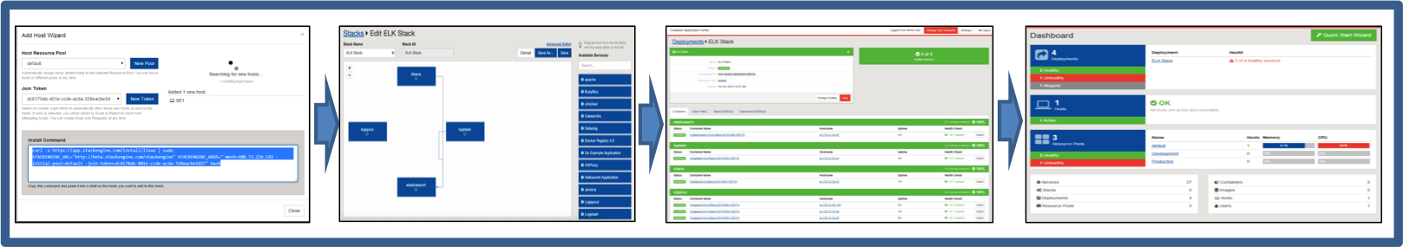
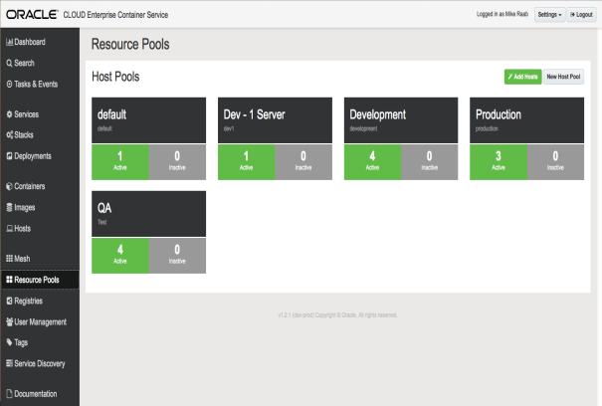
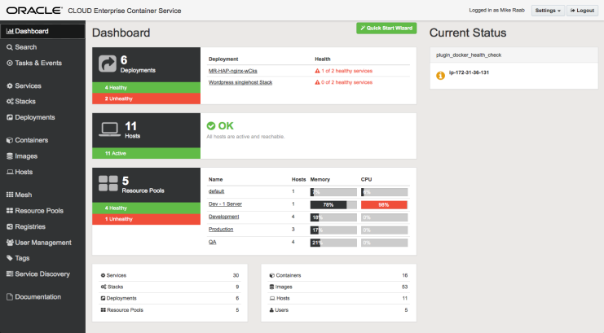
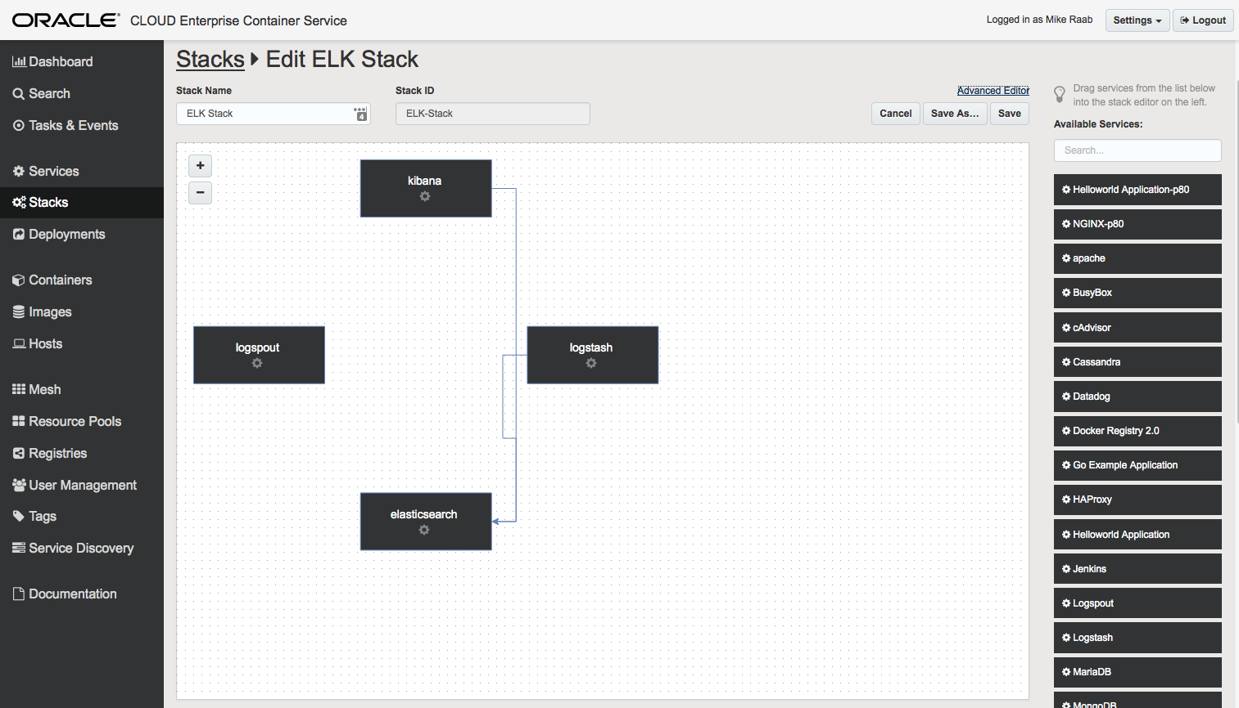
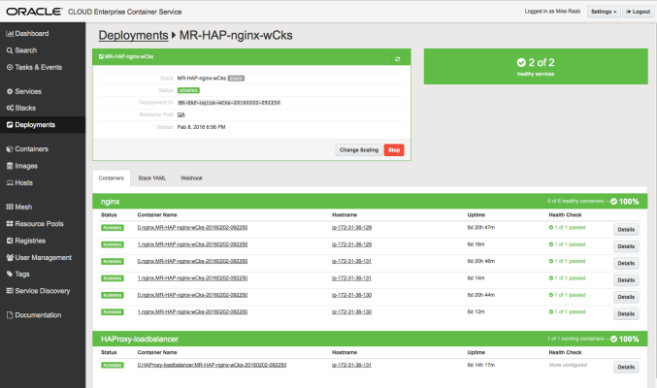
The Oracle Container Cloud Service Providing Out of the Box Functionality
Configuration Management
Application Deployment
Container Orchestration
Operations Management
Define Resource Pools
Add Private Registries
Administer Users / Groups
Edit Create New Services
Compose Application Stacks
Deploy Stacks with 1 Click
Automated Deployment
Multi-Host, Easy Scale Out
Built in Service Discovery
Integrated Health Checks
Unified Dashboard
Monitoring and Auditing

Slide 17
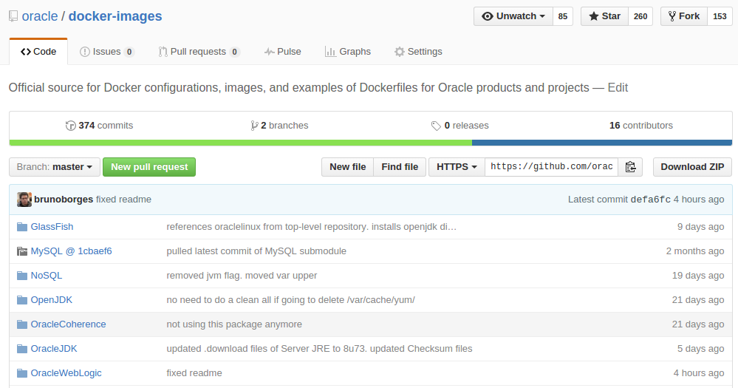
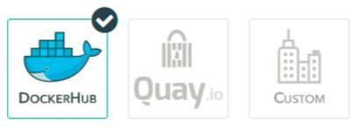



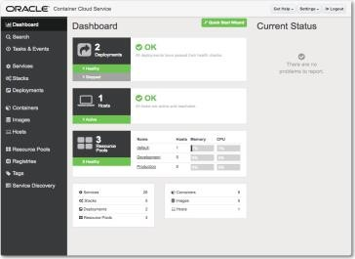
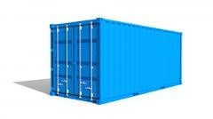

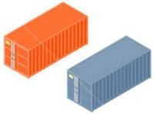
The Oracle Container Cloud Service Architecture
Run Images
or stores in
Image Repo
GIT Hub
Image Registry (Public/Private)
SSH Access / Console UI / REST API
Potential Worker Nodes
Run Images as Containers
OCCS Manager Node
OCCS Worker Node
OCCS Worker Node
1VCPU, 7Gb RAM
2 VCPU, 15Gb RAM
Pulled code and built images

Slide 18
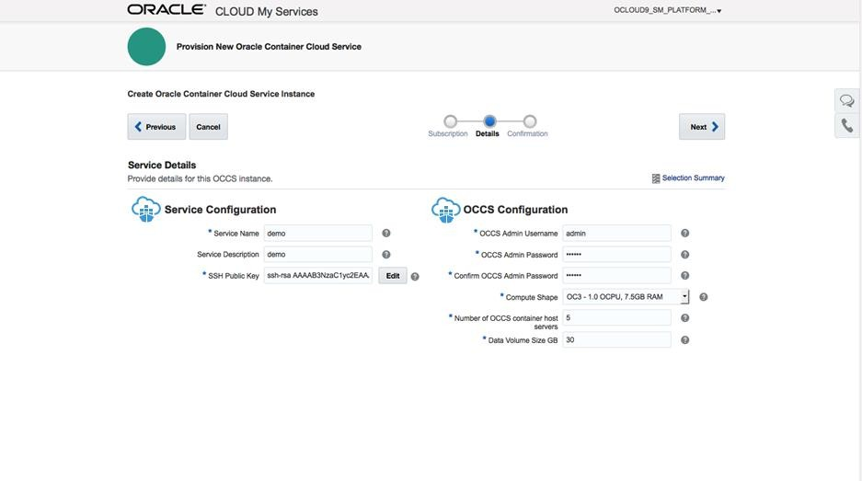
STAGE 1: Configure Instances In the Container Cloud (Environment)
• Create instances of Oracle Container CS quickly. Use this as the hardware environment and use container paid for subscription

Slide 19
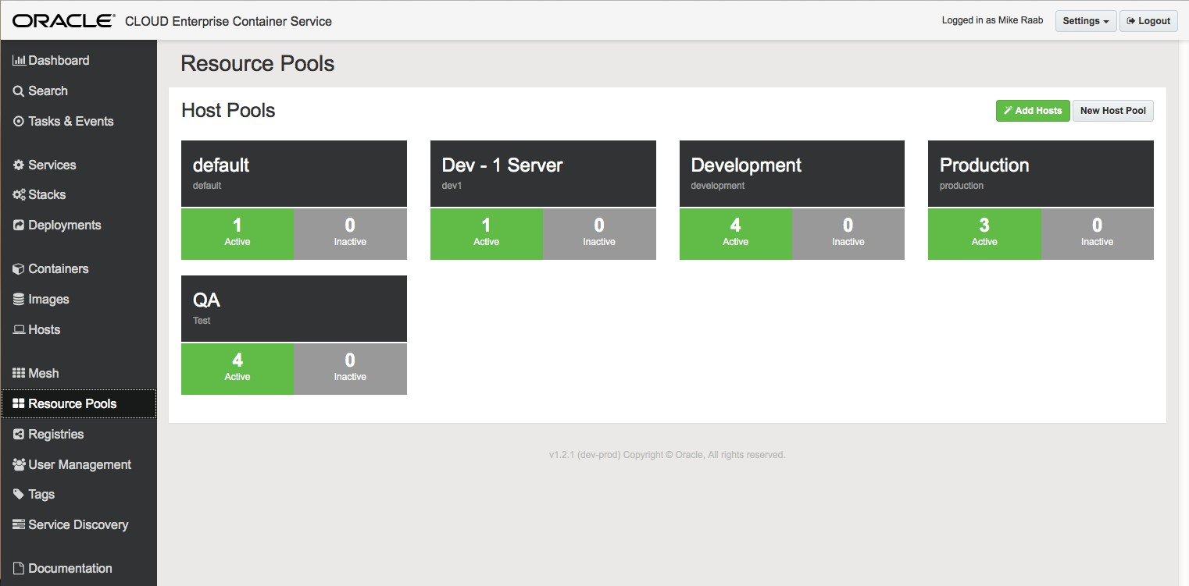

STAGE 1: Design and Implement Pooled Resources
• Create Resource Pools - Groups of Hosts - to match your needs for full Lifecycle Deployments
Pools can align with a
DevOps cycle
Pools can be shared resources

Slide 20
The Build / Run Workflow For OFSAAI On Docker Containers
1
Oracle Linux 7.2 Slim Image
From: Pulled Image of Linux 7 Slim. This is a very cut down and slim version of Linux 7. No persistence and very slim in size / function.
2
1.8-171 Oracle JDK
From: Linux 7 image, install JDK and store as a usable image.
From: Linux 7/JDK, apply docker YAML file, oracle binaries, OS components and build / install oracle enterprise edition (including partitioning) database image. Run: detect first run create or restart of the container with persistence and ports exposed giving a usable database and listener.
3
12.2.0.1 Enterprise Edition Single Instance Container Oracle Database
4
12.2.1.3 FMW Infrastructure (Admin Server and Domain)
From: Linux 7/JDK, apply docker YAML file , OS components, binaries to install WebLogic FMW infrastructure. Run: detect first run create or restart with persistence for domain, cluster and admin server with ports exposed. Additional Managed servers may be started if desired.
5
Application Server 8.0.4 BD_PACK
From: Linux 7/JDK image, apply docker YAML file, OS components and install a FULL Oracle 12.1 client as well as set up OFSAAI binaries 8.0.4 AAI / BD Pack and configuration. Run: detect first run create, install and configure + web deployment or simple restart of application with persistence.

Slide 21
Build / Run Example Execution Time
Table below is to show estimated Image build and Container Run execution times;
Type | Database | FMW | Application
Image Build | 10 Minutes | 10 Minutes | 7 Minutes
Container Run | 10 Minutes * First Run 2 Minutes * Normal startup | 10 Minutes * First Run 2 Minutes * Normal startup | 20 Minutes * First Run 2 Minutes * Normal startup
Image Build (input is YAML file, Configuration Files and Binaries), Output is a stored Image 1 time activity.
Container Run (Input is the Image, Container Start time dependent on first run create or just run)

Slide 22
Docker Image Repository Size
Image | Tag | Image Size | Persistent Volume Size
oracle/ofsaa-fccm | 8.0.4 | 8.332 Gb | 5.4Gb
oracle/fmw-infrastructure | 12.2.1.3 | 5.655 Gb | 1.9Gb
oracle/database | 12.2.0.1-ee | 13.18 Gb | 28Gb
oracle/serverjre | 8 | 269.1 Mb | 0
oraclelinux | 7-slim | 117.3Mb | 0
OFSAA Image requires Optimization which will shrink the image size and reduce layers.
Oracle database is a full enterprise edition, not the Oracle published image which is cut down 3.45Gb size and minimized functionality for development.
Oracle Linux is a slim minimal version around ¼ the size of a typical Linux install. Containers by nature do not run an init.d or have a lot of packages installed.
A Developers challenge is to make an image and container as small as possible with the bare minimum installed and running.

Slide 23
Docker Performance / Overhead Statistics
Container | Purpose | CPU% | Mem Usage / Limit | Mem % | Net I/O | Block I/O
FCCMAPPS | App Server | 0.18% IDLE | 398Mb / FULL | 2.65% | 23.84 MB / 339.8 MB | 23.84 MB / 339.8 MB
FCCMFMWAS | FMW Admin | 0.00% IDLE | 46.75MB/FULL | 0.31% | 367.6 MB / 36.55 MB | 12.54 GB / 398.5 MB
FCCMDB | Oracle DB | 0.30% IDLE | 3.281GB / FULL | 22.34% | 326.5 MB / 423.4 MB | 121.6 GB / 503.6 GB
Docker stats –a gives FULL statistics on containers running in a host as above.
Docker Worker is 2 VCPU, 15Gb RAM and containers are NOT constrained in resources.
To constrain and isolate use GID,UID on containers and also CGROUPS in Linux.
If executing a ‘ps’ command on the host you will see ALL container processes as they share the same userspace / kernel. The container being the parent of a given process tree.

Slide 24
OFSAAI – Docker Deployment Architecture
Network Link
Docker worker
FCCMDB is created / started exposing port 1521 and the ORCL/ORCLPDB1 instance 12.2.0.1 EE.
FCCMFMWAS created / started exposing port 7001 as 9001 and an admin server running in the FCCM_DOMAIN / Infra_cluster1 12.2.1.3 FMW.
FCCMAPP created / started exposing OFSAAI ports. If first start runs OSC.sh / Setup.sh and a web deployment hands off with image configuration.
All 3 containers are networked using the link command and named hosts in run. *
Docker storage is overlayfs in run. *
Persistence is on docker host mapped directory during run of container.
NOTE: Persistent objects content versus Image is to survive restart or rebuild
* Docker version 1.12 in OCC
FCCMDB
FCCMFMWAS
FCCMAPP
FCCM_Domain
OFSAAI Infrastructure
Database
/OFSAAI
Admin Server WebLogic
Storage
Storage
Storage
/u01/data (persistent volumes)
FMW Domain:
FCCM_DOMAIN
(FMW)
DBF / Config:
ORCL (CDB)
ORCLPDB1 (PDB)
(DB)
DOWNLOAD,
FICHOME
FTPSHARE
(FCCM)

Slide 25
OFSAAI Docker Containers Build Process
Git Hub Pull Repo
Oracle FCCM/dockerfiles directory:
File / Directory | Comment
8.0.4 Directory | Contains all dockerfiles, scripts and configuration for the build
buildDockerImage.sh | Build script to make the image
docker_run.sh | Run Script to run a container
README.md | Instructions and Information

Slide 26
OFSAAI Docker Containers Build Process
Oracle FCCM/dockerfiles/8.0.4 directory:
File / Directory | Comment
Checksum | Contains MD5 Checksum for binaries zip
client_install.rsp | Oracle Client Silent Install Response File
container-scripts Directory | Scripts placed into the Image for Container
Dockerfile | Docker YAML File
envCheck.sh | OFSAAI 8.0.4 Install script with Fixes
FIX_INSTALL.sh | Shell Script to perform DB changes required by install
InstallConfig.xml | OFSAAI XML Configuration file
kshrc | Korn Shell Environment
linuxamd64_12c_client.zip | Oracle Client Binaries*
login_banner.sh | Shell Environment file
OFSAAI_InstallConfig.xml | OFSAAI XML Configuration file (Install Config)
Git Hub Pull Repo
* NOTE: Binaries need to be downloaded from Oracle Site.

Slide 27
OFSAAI Docker Containers Build Process
Oracle FCCM/dockerfiles/8.0.4 directory:
File / Directory | Comment
OFS_BD_PACK.xml | OFSAAI XML Configuration file
OFS_BD_SCHEMA_IN.xml | OFSAAI XML Configuration file (database config)
OSC.exp | Expect Oracle Schema Creator OSC.sh script (automation)
pam.d directory | Linux Pam file changes
preinstallcheck.sh | Updated Ofsaai install script fixed
profile | Linux shell Environment file
SETUP.exp | Expect setup.sh script (automation)
SSH.exp | Expect SSH setup / configuration (automation)
tnsnames.ora | Oracle Client database network file
V860826-01.zip | OFSAA BD Pack Binaries *
Git Hub Pull Repo
* NOTE: Binaries need to be downloaded from Oracle Site.

Slide 28
OFSAAI Docker Containers Build Process
Oracle FCCM/dockerfiles/8.0.4/pam.d directory:
File / Directory | Comment
sshd | Linux Sshd configuration in PAM security
su | Linux SU configuration in PAM security
Git Hub Pull Repo
Oracle FCCM/dockerfiles/8.0.4/container-scripts directory:
File / Directory | Comment
App_Deployment.sh | Install script to Deploy EAR on Web App Server (automation)
createOrStartApplication.sh | Container startup script, install & configure or start (automation)
DbConn.class | Java class to test Database readiness / health
DbConn.java | Java script to test Database readiness / health
wait_for_db.sh | Script to execute Java database readiness

Slide 29
OFSAAI Docker Containers Build Process
Image Registry (Public/Private)
SSH Access / Console UI / REST API
Oracle Download
Oracle Software Binaries
Execute: buildDockerImage.sh (A standard script to build images)
Script performs a Checksum on expected binaries that will need to be downloaded and placed in the dockerfile directory.
Script then executes a Docker Build command to execute the Docker YAML file and build the image.
docker build --force-rm=true --no-cache=true -t oracle/ofsaa-fccm:8.0.4 -f Dockerfile .
NOTE: Image Build Order Dependencies and container Run Order:
1. Oracle Linux
2. Oracle JDK
3. Oracle Database
4. Oracle FMW
5. Oracle OFSAA

Slide 30
OFSAAI Docker Containers Build Process
OFSAA Docker YAML File
Command | Comment
FROM oracle/serverjre:8 | Image is based on the Linux 7 / JDK image as a 1st layer
ENV ORACLE_HOME=/u01/oracle \ SCRIPT_FILE=/u01/oracle/container-scripts/* \ VOLUME_DIR1=/u01/oracle/OFSAA/DOWNLOAD \ VOLUME_DIR2=/u01/oracle/OFSAA/FIC_HOME \ VOLUME_DIR3=/u01/oracle/OFSAA/FTPSHARE \ ENV="/u01/oracle/.profile" \ PKG=V860826-01.zip \ FCCMAPPS_OS_PASSWORD=Ofsaa_123 \ PATH=$PATH:/usr/java/default/bin:/u01/oracle/container-scripts:/u01/oracle/client/12.1.0.1/bin | Set Up Environment variables that can be used in the image / containers. Environment variables in any linked container are also available in the environment when containers are run.

Slide 31
OFSAAI Docker Containers Build Process
OFSAA Docker YAML File
Command | Comment
RUN yum -y install iputils && \ yum -y install oracle-rdbms-server-12cR1-preinstall && \ yum -y install net-tools && \ yum -y install unzip && \ yum -y install zip && \ yum -y install expect && \ yum -y install openssh && \ yum -y install openssh-server && \ yum -y install openssh-clients && \ yum -y install sudo && \ yum -y install ksh && \ yum -y install libaio && \ yum -y install redhat-lsb* && \ yum -y clean all && \ rm -rf /var/cache/yum && \ mkdir -p /u01 && \ usermod -d /u01/oracle -s /bin/ksh oracle && \ echo "oracle:$FCCMAPPS_OS_PASSWORD" | chpasswd && \ mkdir -p /u01/oracle/container-scripts && \ mkdir -p /u01/oracle/OFSAA/FIC_HOME && \ mkdir -p /u01/oracle/OFSAA/FTPSHARE && \ mkdir -p /u01/oracle/OFSAA/DOWNLOAD && \ mkdir -p /u01/oracle/OFSAA/install && \ mkdir -p /u01/oracle/client && \ mkdir -p /u01/oracle/oraInventory && \ mkdir -p /u01/oracle/client/12.1.0.1 && \ mkdir -p /u01/oracle/tnsadmin | As root, yum install required Linux packages, IPUTILS, ORACLE RDBMS 12cR1 Preinstall, NET-TOOLS, UNZIP, ZIP, EXPECT, OPENSSH, OPENSSH-SERVER, OPENSSH-CLIENTS, SUDO, KSH, LIBAIO, REDHAT-LSB Setup oracle User and Create directories

Slide 32
OFSAAI Docker Containers Build Process
OFSAA Docker YAML File
Command | Comment
ADD profile /u01/oracle/.profile ADD kshrc /u01/oracle/.kshrc ADD login_banner.sh /u01/oracle/.login_banner.sh ADD tnsnames.ora /u01/oracle/tnsadmin/tnsnames.ora | Copy into the image the required files from the host.
COPY container-scripts/* /u01/oracle/container-scripts/ | Place all the container scripts into the image directory
COPY linuxamd64_12c_client.zip client_install.rsp /u01/oracle/OFSAA/DOWNLOAD/STAGE_ORACLE_CLIENT/ | Copy the Oracle Client binaries and response file into a staging directory.
COPY pam.d/* /etc/pam.d/ | Copy all the host pam.d directory files into the image
RUN unzip /u01/oracle/OFSAA/DOWNLOAD/STAGE_ORACLE_CLIENT/linuxamd64_12c_client.zip -d /u01/oracle/OFSAA/DOWNLOAD/STAGE_ORACLE_ CLIENT && \ chown -R oracle:oinstall /u01/oracle && \ chown -R oracle:dba /u01/oracle/oraInventory && \ chmod 775 /u01/oracle/oraInventory | Unzip the Oracle binaries and set the required permissions

Slide 33
OFSAAI Docker Containers Build Process
OFSAA Docker YAML File
Command | Comment
USER oracle RUN /u01/oracle/OFSAA/DOWNLOAD/STAGE_ORACLE_CLIENT/client/runInstaller -ignoreSysPrereqs -ignorePrereq -waitforcompletion -sho wProgress -silent -responseFile /u01/oracle/OFSAA/DOWNLOAD/STAGE_ORACLE_CLIENT/client_install.rsp | As the Oracle user run the Oracle Client installer with the supplied response file.
USER root COPY $PKG /u01/oracle/container-scripts | As the user root copy the OFSAA downloaded binaries into the image.
ADD envCheck.sh preinstallcheck.sh OFS_BD_SCHEMA_IN.xml SETUP.exp OSC.exp SSH.exp FIX_INSTALL.sh OFS_BD_PACK.xml OFSAAI_Install Config.xml InstallConfig.xml /u01/oracle/container-scripts/ | Copy into the image scripts and configuration files ready for the build / install

Slide 34
OFSAAI Docker Containers Build Process
OFSAA Docker YAML File
Command | Comment
RUN chown oracle:oinstall -R /u01/oracle/container-scripts && \ chmod -R +xr /u01/oracle/container-scripts && \ chmod -R +xr /u01/oracle/OFSAA/install && \ /usr/bin/ssh-keygen -A && \ /u01/oracle/oraInventory/orainstRoot.sh && \ echo "oracle ALL = NOPASSWD: /usr/sbin/sshd" >> /etc/sudoers | Ensure File ownership and permissions are correct for the oracle user. Generate SSH keys to ensure SSHD is able to start. Execute the orainstRoot script post client install Set up the sudo file so that oracle can start sshd
VOLUME $VOLUME_DIR1 $VOLUME_DIR2 $VOLUME_DIR3 | Create docker volume for FTPSHARE,DOWNLOAD, FICHOME
EXPOSE 6500 6501 6505 6507 6509 6510 6666 9999 10101 | Open OFSAA required ports from the image to the host
USER oracle CMD ["/u01/oracle/container-scripts/createOrStartApplication.sh"] | As the oracle user, set up so the container on start will execute this script. It will detect a first run (create) or startup of application.

Slide 35
Docker RUN commands To Start Containers
*NOTE: Order is important as containers are dependent on each other *** Only in run build / configuration completed.
Oracle Database 12.2.0.1 Container
runOracle.sh script determines first run create or restart
docker run -t -d -e="occs:availability=per-pool" -e="occs:scheduler=random" -e="occs:description=OFSAA DB Server" \
--name FCCMDB -p 1521:1521 -p 5500:5500 -e ORACLE_SID=ORCLCDB -e ORACLE_PDB=ORCLPDB1 \
-e ORACLE_PWD=Oradoc_db1 -e ORACLE_CHARACTERSET=AL32UTF8 -v /u01/data/DB:/opt/oracle/oradata \
oracle/database:12.2.0.1-ee
Oracle FMW 12.2.1.3 Container
createOrStartInfraDomain.sh script determines first run create or restart
docker run -t -d -e="RCUPREFIX=FCCMFMW" -e="DB_PASSWORD=Oradoc_db1" -e="DB_USERNAME=sys" \
-e="DB_SCHEMA_PASSWORD=YgauGh0a" -e="ADMIN_USERNAME=weblogic" \
-e="CONNECTION_STRING=FCCMDB:1521/ORCLPDB1" -e="ADMIN_PASSWORD=FdyY3XJA" \
-e="DOMAIN_NAME=FCCM_Domain" -e="occs:availability=per-pool" -e="occs:scheduler=random" \
-e="occs:description=FMW INFRA ADMIN DOMAIN FCCM" -v=/u01/data/FMW:/u01/oracle/user_projects:rw \
-p=9001:7001/tcp --link=FCCMDB:FCCMDB --name=FCCMFMWAS --hostname=FCCMFMWAS \
"oracle/fmw-infrastructure:12.2.1.3"
Oracle OFSAA 8.0.4 BD_PACK Container
createOrStartApplication.sh script determines first run create or restart
docker run -t -d -e="occs:availability=per-pool" -e="occs:scheduler=random"
-e="occs:description=OFSAA OFSAAI (FCCM) Application Server" --name=FCCMAPPS --hostname=FCCMAPPS \
--link FCCMDB:FCCMDB --link FCCMFMWAS:FCCMFMWAS \
-v=/u01/data/FCCM/DOWNLOAD:/u01/oracle/OFSAA/DOWNLOAD:rw \
-v=/u01/data/FCCM/FIC_HOME:/u01/oracle/OFSAA/FIC_HOME:rw \
-v=/u01/data/FCCM/FTPSHARE:/u01/oracle/OFSAA/FTPSHARE:rw \
"oracle/ofsaa-fccm:8.0.4"

Slide 36
Docker RUN command in OFSAAI Container
createOrStartApplication.sh
Command | Comment
sudo /usr/sbin/sshd -D & | In the container start SSHD (No Init on containers)
if [ ! -d /u01/oracle/OFSAA/DOWNLOAD/OFS_BD_PACK ]; | Check to see if OFS_BD_PACK directory exists in the Download directory. If NOT then first time, so run install / configure. If YES perform a normal startup.
chmod 775 /u01/oracle/OFSAA/DOWNLOAD chmod 775 /u01/oracle/OFSAA/FTPSHARE chmod 775 /u01/oracle/OFSAA/FIC_HOME | For install, set required permissions to directories
unzip /u01/oracle/container-scripts/$PKG -d /u01/oracle/OFSAA/DOWNLOAD chmod -R +xr /u01/oracle/OFSAA/DOWNLOAD | Unzip and set permissions on OFSAA binaries

Slide 37
Docker RUN command in OFSAAI Container
createOrStartApplication.sh
Command | Comment
cp /u01/oracle/container-scripts/OFS_BD_SCHEMA_IN.xml /u01/oracle/OFSAA/DOWNLOAD/OFS_BD_PACK/schema_creator/conf cp /u01/oracle/container-scripts/preinstallcheck.sh /u01/oracle/OFSAA/DOWNLOAD/OFS_BD_PACK/OFS_AAI/bin cp /u01/oracle/container-scripts/envCheck.sh /u01/oracle/OFSAA/DOWNLOAD/OFS_BD_PACK/OFS_AAI/bin cp /u01/oracle/container-scripts/OSC.exp /u01/oracle/OFSAA/install cp /u01/oracle/container-scripts/SETUP.exp /u01/oracle/OFSAA/install cp /u01/oracle/container-scripts/SSH.exp /u01/oracle/OFSAA/install cp /u01/oracle/container-scripts/FIX_INSTALL.sh /u01/oracle/OFSAA/install cp /u01/oracle/container-scripts/OFS_BD_PACK.xml /u01/oracle/OFSAA/DOWNLOAD/OFS_BD_PACK/conf cp /u01/oracle/container-scripts/OFSAAI_InstallConfig.xml /u01/oracle/OFSAA/DOWNLOAD/OFS_BD_PACK/OFS_AAI/conf cp /u01/oracle/container-scripts/InstallConfig.xml /u01/oracle/OFSAA/DOWNLOAD/OFS_BD_PACK/OFS_BD/conf cp /u01/oracle/OFSAA/DOWNLOAD/OFS_BD_PACK/OFS_AAI/conf/log4j.xml /u01/oracle/OFSAA/DOWNLOAD/OFS_BD_PACK/OFS_BD/conf | Copy all configuration files and scripts / fixes into the right locations. Note copy is used due to docker storage type. If a mv occurs or a rm of files created in an earlier image layer then the files / storage gets corrupted. This is addressed in newer docker versions and overlay2 Docker has many storage types, overlayfs is used in OCC and docker 1.12. Overlayfs and overlay2fs are ok for database performance.

Slide 38
Docker RUN command in OFSAAI Container
createOrStartApplication.sh
Command | Comment
SSH.exp | Execute SSH setup between all 3 servers. Application, Web server and database. Set up ssh keys for web server. Expect is used to automate the required user interaction prompts.
OSC.exp | Execute the Oracle schema creator, OSC.sh. The expect script deals with the user interaction required. This connects to the database and creates schemas, users etc.
FIX_INSTALL.sh | This is a script to implement database changes required post the Oracle schema creator required by the OFSAA installer.
sed -i "s/read ans/$ANS/g" /u01/oracle/OFSAA/DOWNLOAD/OFS_BD_PACK/bin/setup.sh | Deal with the interaction required by setup.sh
/usr/bin/ksh setup.sh SILENT | Run the Oracle OFSAA Installer, Automated Version.
ssh -t FCCMFMWAS /u01/oracle/container-scripts/create_OFSAAI_ds.sh | Remotely run the JNDI create data source script * Added to the FMW image / container. This creates FIC MASTER.
scp ${FIC_HOME}/ficweb/OFSAAI.ear FCCMFMWAS:/u01/oracle/user_projects/domains/FCCM_Domain/applications/OFSAAI.ear.o | Copy over to the web server the application EAR.

Slide 39
Docker RUN command in OFSAAI Container
createOrStartApplication.sh
Command | Comment
nohup $FIC_HOME/ficapp/common/FICServer/bin/startofsaai.sh & $FIC_HOME/ficapp/icc/bin/iccserver.sh nohup $FIC_HOME/ficdb/bin/agentstartup.sh & | Start up the application processes for deployment. Note script has to ensure inside directories correctly to avoid errors due to hard coding directory movement ../../ The startup commands are used also if this is just a restart of the container without any need to install / configure.
ssh -t FCCMFMWAS < /u01/oracle/container-scripts/App_Deployment.sh | Remotely execute the app deployment script on the web application server.
App_Deployment.sh
Command | Comment
if [ -f /u01/oracle/user_projects/domains/FCCM_Domain/applications/OFSAAI.ear.o | Check the EAR file is copied over to the Web Server.
mkdir -p /u01/oracle/user_projects/domains/FCCM_Domain/applications/OFSAAI.ear mkdir -p /u01/oracle/user_projects/domains/FCCM_Domain/applications/OFSAAI.ear/OFSAAI.war | Create the EAR directory / WAR directories
jar -xvf /u01/oracle/user_projects/domains/FCCM_Domain/applications/OFSAAI.ear/OFSAAI.ear jar -xvf /u01/oracle/user_projects/domains/FCCM_Domain/applications/OFSAAI.ear/OFSAAI.war/OFSAAI.war | Unpack the JAVA EAR / WAR files / move as needed

Slide 40
Docker RUN command in OFSAAI Container
App_Deployment.sh
Command | Comment
sed -i "s?/UserProvisioning?/userProvisioning?g" web.xml | Apply a 12.2.1.3 FMW fix to the web.xml solving a deployment error.
/u01/oracle/container-scripts/OFSAAI_deployapp.sh | Execute the OFSAAI WLST deployment script. This was also added to the FMW image along with JNDI script and SSH.
OFSAAI_Deployapp.sh
Added to container-scripts in the FMW image build
Command | Comment
/u01/oracle/wlserver/server/bin/setWLSEnv.sh | Set up Environment for WLST
java weblogic.Deployer -verbose -adminurl t3://${HOST}:${PORT} -username ${AdminUser} -password ${AdminPassword} -nostage -name ${AppName} -targets AdminServer -deploy ${SourcePath}/${Artifact} | Execute FMW built in weblogic.deployer. Input the admin server url, username, password, location of unpacked EAR/WAR and the target which is the admin server.
NOTE: Weblogic deploy command specific to FMW 12.2.1.3. Other deploy commands error / don’t deploy correctly

Slide 41
Docker RUN command in OFSAAI Container
create_OFSAAI_ds.sh
Added to container-scripts in the FMW image build
Command | Comment
/u01/oracle/wlserver/server/bin/setWLSEnv.sh | Set up Environment for WLST
java weblogic.WLST /u01/oracle/container-scripts/create_data_source.py -p /u01/oracle/container-scripts/myDomain-ds.properties | Execute the WLST python script create_data_source.py using the properties file providing the admin server URL, username and password as well as the JNDI data source requirements for FIC MASTER.

Slide 42
Other Docker YAML / Builds Available
Name | Purpose / comment
ContainerCloud | Demo stack on NGINX
GlassFish | 4.1.1, 4.1.2, 5.0 Glassfish versions
GraalVM | 0.22 version, Graal is a just-in-time (JIT) compiler for the JVM focused on peak performance and multi-languages.
NoSQL | Oracle Database, 3.4.7, 3.5.2, 4.0.9, 4.3.11, 4.4.6, 4.5.12
OpenJDK | Oracle Linux with OpenJDK versoin 6,7,8
OracleBI | OBIEE versions 12.2.1.2 & 12.2.1.3. Has been fully tested
OracleCloudInfrastructure | Terraform OCI / Cloud Infrastructure Tools
OracleCoherence | Coherence versions: 12.2.1.0.0, 12.2.1.2.0
OracleDatabase | Rac / single instance. NOT image in docker hub! Has versions 11.2.0.2, 12.1.0.2, 12.2.0.1. Available : SE,XE,EE. 12.2.0.1 EE is used for this build and has been adjusted for SQLNET.ora client versions also pam.d changes and ssh. Container DB created with persistence.

Slide 43
Other Docker YAML / Builds Available
Name | Purpose / comment
OracleDataIntegrator | ODI versions: 12.2.1.2.6, 12.2.1.3.0
OracleEDQ | Customer Screening / Watchlist 8.0.4 built and tested.
OracleFMWInfrastructure | 12.2.1.2 and 12.2.1.3 WLS/FMW. 12.2.1.3 used for this engineering exercise. Image has been extended for sudo, ssh, wlst scripts required.
OracleGoldenGate | Oracle Golden Gate for DEVOPS, 12.2.0.1.1, 12.3.0.1.2
OracleHTTPServer | OHS, 12.2.1.2.0, 12.2.1.3.0. Tested but not used!
OracleInstantClient | Oracle instant client, 12.2.0.1
OracleJava | JDK 1.8-171 used in this build. Used in Engineering build as required on top of Linux slim image to build other images / containers.
OracleLinux | Build script to pull Oracle Linux 7 image
OracleRestDataServices | Oracle Rest Data Services ORDS 3.0.10

Slide 44
Other Docker YAML / Builds Available
Name | Purpose / comment
OracleSOASuite | SOA SUITE, 12.2.1.2, 12.2.1.3
OracleTuxedo | Oracle Tuxedo
OracleWebCenterSites | Oracle WebCenter Sites 12c R2 (12.2.1.3.0)
OracleWebLogic | 12.1.3, 12.2.1,12.2.1.1,12.2.1.2,12.2.1.3 basic Weblogic server

Slide 45
Docker Engineering: Next Steps
Remove hard coding to make configuration easier / simpler
OSC.exp, SETUP.exp , dockerfile on FMW, dockerfile for DB, FMW/container-scripts/deployment scripts
Optimize the docker YAML so make the container smaller
Look at OBIEE and OFSAA configuration / setup
Look at ROAR deployment
Look at Scenario Manager install
Look at OTHER OFSAA Packs to Extend images further
Review Application logs / Health Checks
Review ALL Environment Variables in the 3 containers / Builds
Examine running multiple stacks on docker hosts not just the 1
Tidy up READ.ME and GitHub content before publish
Document Oracle Cloud Containers environment and place into OraDocs with other material
Review feedback documents on OSC.sh and Setup.sh from automation exercise

Slide 46
Appendix - Useful Docker Commands
Command | Comment
Docker build | Used to build an image from a docker YAML file
Docker run | Used to run a container from an image
Docker exec –ti CONTAINER COMMAND | Used to execute a command in a container or start a shell
Docker stats –a | Show all stats on all containers
Docker images | List all the images available
Docker ps | Show all containers running
Docker ps –a | Show all containers running and stopped
Docker volume (create,inspect,ls,rm) | Used to manage volumes
Docker network (connect,create,disconnect,inspect,ls,rm) | Used to manage networks
Docker top | Used to run top for a container
Docker rm | Remove a container
Docker rmi | Remove an image

Slide 47
Appendix - Useful Docker Commands
Command | Comment
Docker port | List a containers ports
Docker logs CONTAINER (–f) | List / inspect or tail a container log (console)
Docker export | Export a containers filesystem as a tar archive
Docker –help | Main help of all docker commands

